Slide 1


Slide 2
Rise of china
Since China’s open-door policy in the 1980s, China has quickly grown to become an economic powerhouse. Along with its rapid economic development, China has also quickly recognized the importance of global soft power.
From the mid-2000s onwards, China has engaged in a formal quest to increase its soft power. In particular, the Chinese government strives to publicize Chinese culture and traditions to strengthen the influence of Chinese culture worldwide.

Slide 3
Interest in Chinese content
Due to the Chinese government’s active publicizations, as well as global interest in China’s booming economy, there has since been a strong interest in Chinese language and culture. For instance, there are a large number of language and cultural institutions overseas, with the US accounting for over 25% of all overseas Confucius Institutes.
This trend is also evident in the media industry, as there are more and more Chinese cultural products being exhibited overseas. For instance, the number of Chinese films being exhibited are increasing by the year, and there are even dedicated streaming platforms for Chinese/Asian content.

Slide 4
What to distribute?

Slide 5
Problems of distributing Chinese content
Commercial films: inability to reach beyond Chinese audiences i.e. >80% of audiences for Wandering Earth are Chinese
Arthouse films: limited audience pool, fierce competition between all foreign arthouse films i.e. NA box office for Long Day’s Journey into Night (best performing arthouse film in April 2019) is $400k, approximately 20k views
Documentary films: even smaller audience pool, many films are politically sensitive
TV series: sometimes high cultural barrier i.e. 1st episode of The Longest Day in Chang’an had 1 million views on YouTube, by the 4th episode, dropped to 65k
Animation films/series: few quality productions

Slide 6
Uniquely suited to educate audiences
Lower acquisition prices
Lower cultural barriers
Lower political risks
Choice of product
Docuseries

Slide 7
how to distribute?

Slide 8
Media consumption
Increasingly online
FRAGMENTATION OF SVOD MARKET
CHANGE IN CONSUMER BEHAVIOR
60% OF YOUNG ADULTS PRIMARALY USE STERAMING TO WATCHING TV
GROWING COMPETITION FROM NICHE PLATFORMS
DECLINE IN “SOLOS”, 71% OF MARKET SUBSCRIBE TO MULTIPLE PLATFORMS

Slide 9
Problems in streaming
Fake competition:
Competing for monopoly on content
High acquisition cost:
Limited customer value beyond monopolizing content
No digital first sale rights:
Additional cost per view as compared to DVD rental
High operational costs
Fragmentation of market according to exclusive content
Price competition
Inability to make money

Slide 10
Companies BREAKING EVEN
30-day content catalogue
Low acquisition cost
Lower acquisition cost for documentaries
Higher prices from education licensing
Price
Cost
To break even: OR

Slide 11
How to make our business viable?

Slide 12
Focus on providing additional value for customers make our services indispensable even if the content is available on other platforms/through piracy

Slide 13
Production description
CORE PRODUCT: EDUCATIONAL STREAMING PLATFORM
Subtitles for docuseries in different languages
Small quizzes at the end of each episode
Have volunteer teachers manage discussion forums for language learners
Hyperlink keywords in subtitles to external Wikipedia pages

Slide 14

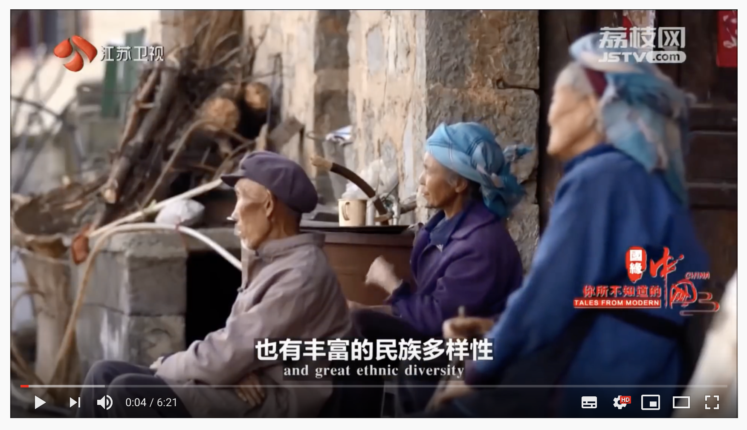

Sample interface
Tales from Modern China Season 3 EP 2
Suggested Videos
Provide accurate subtitles in different languages
Comments Section

Slide 15
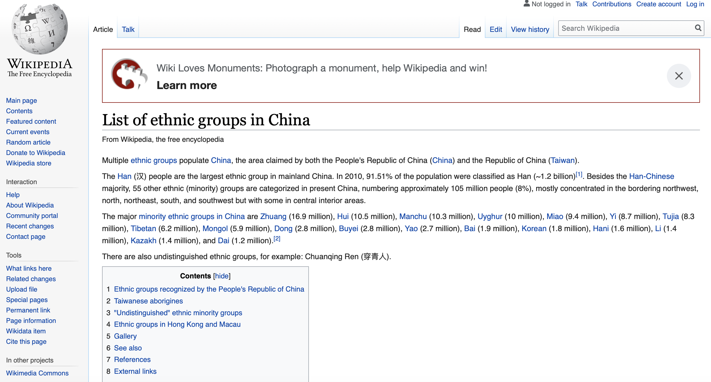
Sample interface
Tales from Modern China Season 3 EP 2
When hovering curser over keywords, short intros appear on the side of the screen/embedded links link to Wikipedia page
Suggested Videos
Comments Section

Slide 16
Sample interface
Tales from Modern China Season 3 EP 2
Suggested Videos
中国有多少个民族?
How many races are there in China?
12
36
56
70
Provide 3 short questions after every episode to test viewers’ knowledge
Comments Section

Slide 17
Sample interface
Banner
Volunteer teachers to monitor discussion forum and respond to questions, learners can also interact among themselves
Forum
Statistics
Latest posts
Topics

Slide 18
Market potential
Ascendia Pictures, Inc was founded in 2019 to acquire and distribute the best Chinese content. We specialize in documentary distribution and aim to gradually expand to distribute a greater variety of contents to audiences worldwide.
We aim to distribute to all major digital platforms including iTunes, Hulu, Amazon, Vimeo and others to provide extensive coverage and a lasting impact on global audiences.

Slide 19
5 million
4.5 million
CHINESE AMERICANS IN 2017
OVERSEAS CHINESE IN US

Slide 20
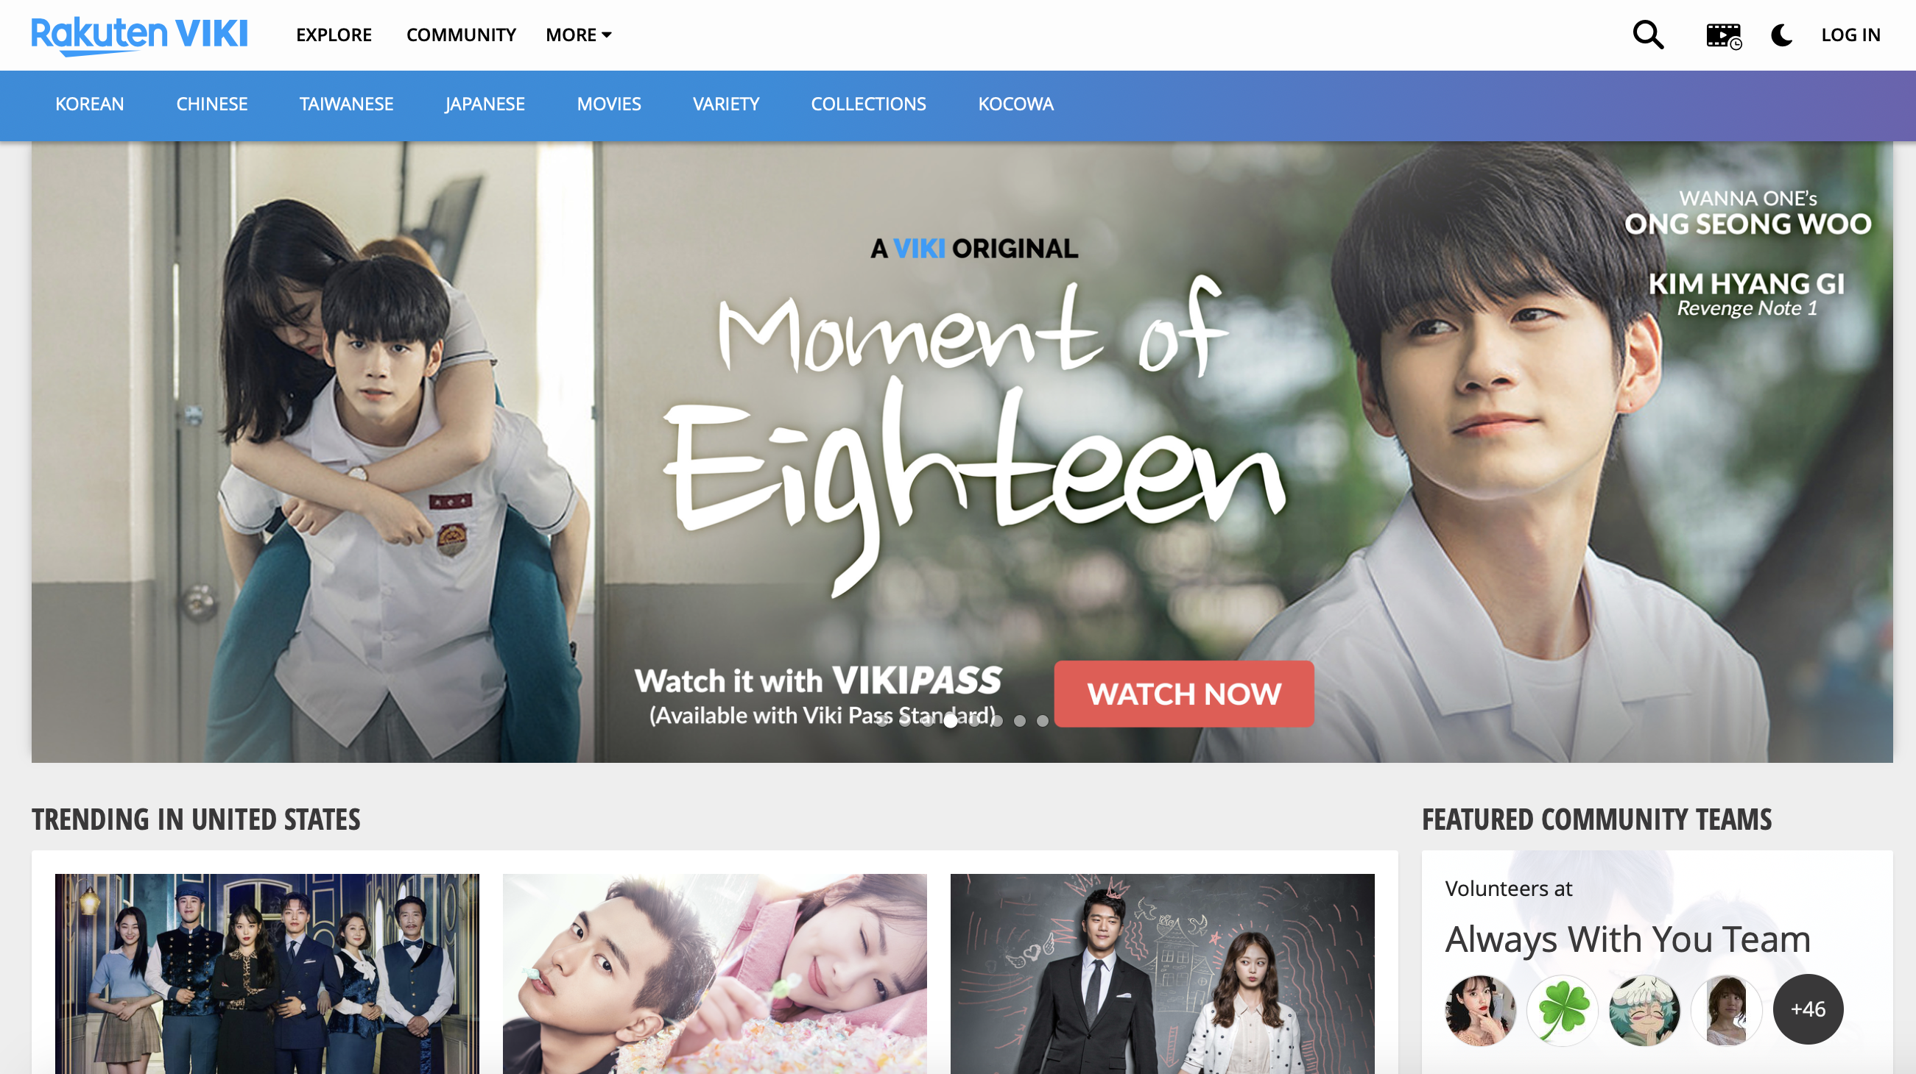
Major competitors: VIKI
Established in 2007
Positioned as a language-learning tool
Viki puts up Asian content on its site, and community volunteers subtitle content in their preferred languages under a Creative Common license

Slide 21
strengths
weakness
Large selection of hottest Asian content: TV series, K-pop content, etc.
Lower cost from volunteer subtitling for free
Able to monetize the subtitles on other platforms i.e. Netflix, Hulu, etc.
Subtitling is the only form of language learning
Higher costs associated with acquiring popular series

Slide 22
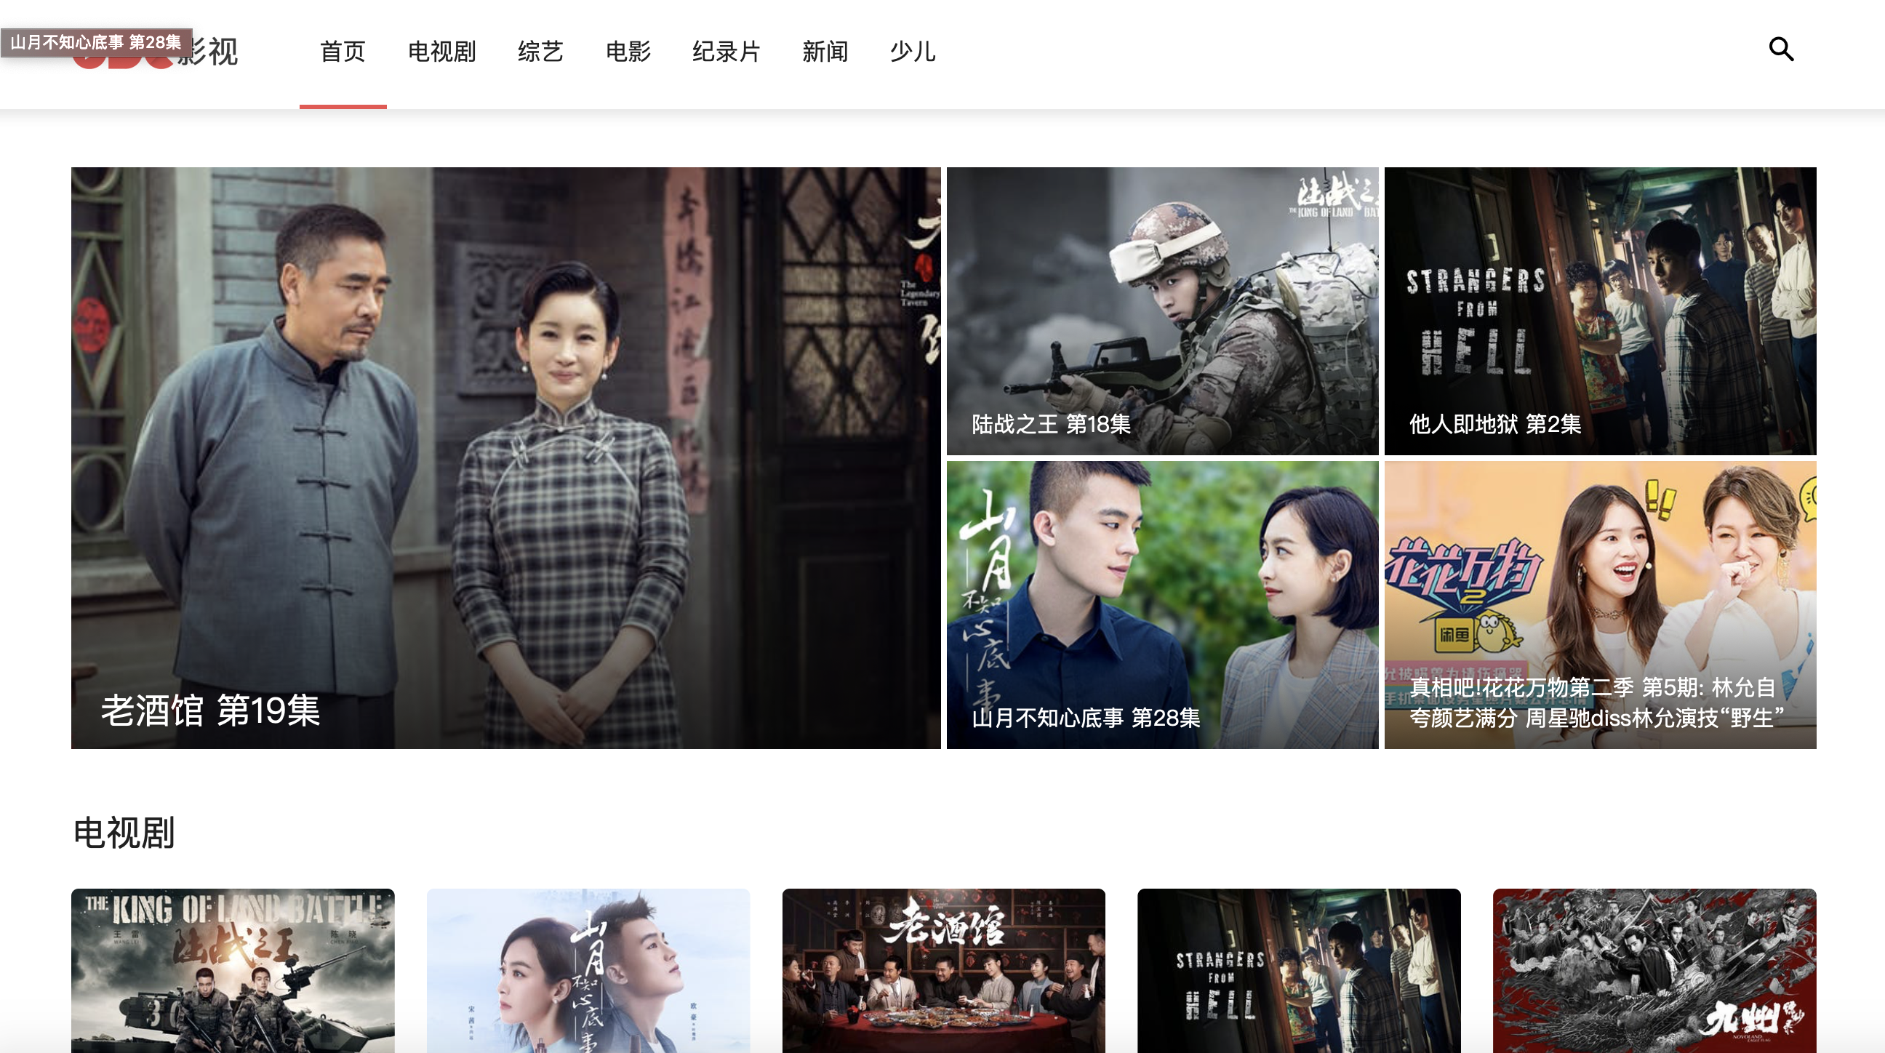
Major competitors: ODC
Established in 2018
Positioned as a streaming platform providing the hottest Chinese content, including: TV series, reality shows, movies, documentaries, news, etc.

Slide 23
strengths
weakness
Large selection of hottest Chinese content
No obvious monetization method (neither a subscription model nor an advertisement based model)
Lack of foreign language subtitles
High possibility of pirated content (inaccessible in China even using VPN, Story of Yanxi Palace is confirmed to be pirated)

Slide 24

Major competitors: Others
Asian content streaming platform
Not focused on educational angle
Most comprehensive streaming platform
Limited Asian (esp. Chinese) content

Slide 25

Business model
REVENUE
COST
Streaming advertisements
B2B educational subscriptions
B2C subscriptions
Website & app development
Content acquisition
Operating i.e. subtitling, others
Marketing
Administrative

Slide 26
Business organization
Business Development
Acquisition
Tech Support
Sales & Marketing
Prepare business plan
Look for funding
Build relationships with content partners in China
Determine most suitable content
Negotiate deals
Determine innovation feasibility
Website & App development
Subtitling & troubleshooting
Find suitable collaboration partners
Negotiate marketing partnerships
Monitor and adjust strategies

Slide 27
Business organization
Business Development
Acquisition
Tech Support
Sales & Marketing
Prepare business plan
Look for funding
Build relationships with content partners in China
Determine most suitable content
Negotiate deals
Determine innovation feasibility
Website & App development
Subtitling & troubleshooting
Find suitable collaboration partners
Negotiate marketing partnerships
Monitor and adjust strategies

Slide 28
Meet the team
SHAY HU
CHIEF EXECUTIVE OFFICER
ECHO ZHAO
CHIEF MARKETING OFFICER
SHUANG LIANG
CHIEF OPERATING OFFICER
RAVEN ZHANG
CONSULTANT
HANZHI LV
CONSULTANT
CALVIN CHEN
CONSULTANT
RACHAEL HUANG
CONSULTANT
SHUXIAN LI
CONSULTANT

Slide 29
CONTACT DETAILS
WEBSITE
www.ascendiapictures.com
PHONE NUMBER
917-520-0868
EMAIL ADDRESS
shayh@ascendiapictures.com

Slide 30
appendix

Slide 31





Content partners
More to come

Slide 32
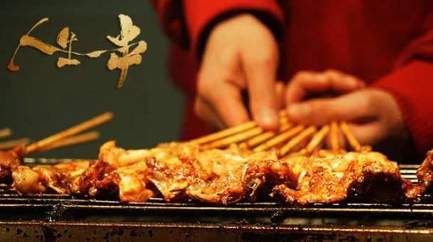

Content genres
FOOD
TRAVEL
CHINESE CULTURE
PLANTS & ANIMALS
More to come

Slide 33
600 years of kunqu opera
Director: Li Chen
Year: 2007
Episodes: 8
Running Time: 38min/episode
Country: China
Language: Mandarin
Genre: Chinese culture
Subjects of interest: Language learners, audiences interested in Chinese culture

Slide 34
600 years of kunqu opera
600 Years of Kunqu Opera is the first docuseries to explore the heritage of Kunqu Opera in China. The series narrates the origins, characteristics and influences of this art form and is regarded as one of the most important docuseries aimed at promoting traditional Chinese culture.
The series has received a broadcast release on Jiangsu Station and CCTV. It has also been released in DVD format in China and Taiwan and is currently available on Sohu TV in China.

Slide 35
The tale of Chinese medicine
Director: Chao Gan
Year: 2016
Episodes: 6
Running Time: 40min/episode
Country: China
Language: Mandarin
Genre: Chinese culture, plants & animals
Subjects of interest: Language learners, audiences interested in Chinese culture

Slide 36
The tale of Chinese medicine
The Tale of Chinese Medicine is a docuseries commissioned by the National Administration of Traditional Chinese Medicine to document the origins, heritage and developments of Chinese medicine. It is a visually stunning series that captures the history of different ingredients from forests, deserts and other exotic regions in China.
The series has received a broadcast release on Jiangsu Station and CCTV and has received raving reviews. The series is also currently available on iQiyi, one of China’s leading streaming platforms.

Slide 37
tales from modern china
Director: Giulia Clark
Year: 2017
Episodes: 6
Running Time: 23min/episode
Country: China, UK
Language: Mandarin, English
Genre: Travel, Modern China
Subjects of interest: Language learners, audiences interested in modern China

Slide 38
Tales from modern china
Tales from Modern China (Modern China) is a co-production between Jiangsu Broadcasting Station and BBC. The series aimed to create a high quality docuseries that explores different facets of modern China. In particular, Modern China attempted to capture authentic Chinese society and help western audiences get a better understanding of modern China.
The series is divided into 6 episodes, each focusing on one geographical region of China (central, northeast, northwest, south, southeast, and southwest). Each episode explores the cultural differences in the different regions and was aired on both Jiangsu Station and BBC World News in 2017. The series is also currently available on iQiyi, one of China’s leading streaming platforms.

